Slide 1
Intro To Statistics
Zachary Taebel
September 15, 2026

Slide 2
Topics
Why do we need statistics in oceanography?
Probability
Random variables
Probability distributions
Empirical and theoretical statistics

Slide 3
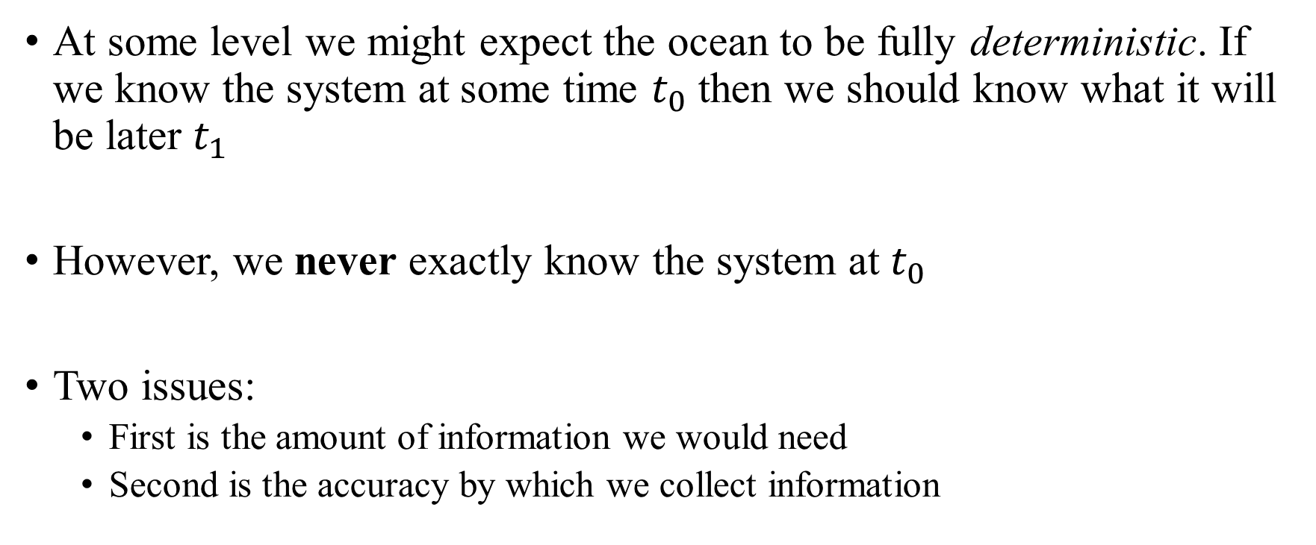
Why do we need statistics in oceanography?
At some level we might expect the ocean to be fully deterministic. If we know the system at some time $t_{0}$ then we should know what it will be later $t_{1}$
However, we never exactly know the system at $t_{0}$
Two issues:
  First is the amount of information we would need
  Second is the accuracy by which we collect information

Slide 4
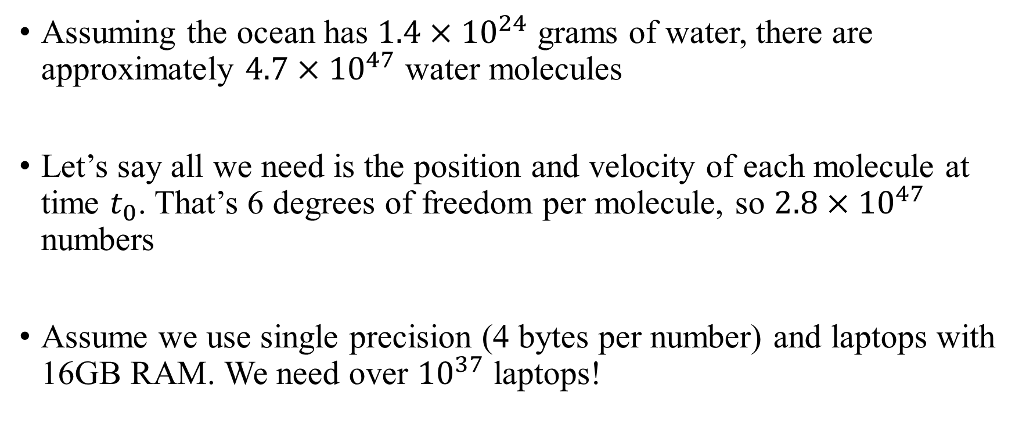
How much information do we need?
Assuming the ocean has $1.4×{10}^{24}$ grams of water, there are approximately $4.7×{10}^{47}$ water molecules
Let’s say all we need is the position and velocity of each molecule at time $t_{0}$. That’s 6 degrees of freedom per molecule, so $2.8×{10}^{47}$ numbers
Assume we use single precision (4 bytes per number) and laptops with 16GB RAM. We need over ${10}^{37}$ laptops!

Slide 5
How accurate is the information we obtain?
Real-world instruments and computers can only be so precise
Observations will be biased by noise, drift, resolution, etc
  Often unclear what is signal vs what is noise
Necessary post-processing can introduce artificial biases.
  E.g. interpolation is a low-pass filter
Long story short, the data we do collect are approximations of true values

Slide 6




An Analogy: Plinko
$$t_{0}$$
Imagine we are tracking a parcel of fluid moving through the ocean
This parcel “collides” with other parcels, causing its trajectory to change
If we could perfectly capture all parcels in its way, we could determine exactly what its trajectory will be
$$t_{1}$$

Slide 7

An Analogy: Plinko
$$t_{0}$$
But we can’t perfectly capture all other parcels!
Our measurements aren’t perfectly accurate
$$t_{1}$$

Slide 8
An Analogy: Plinko
$$t_{0}$$
But we can’t perfectly capture all other parcels!
Our measurements aren’t perfectly accurate
Our measurements are sparse
$$t_{1}$$

Slide 9
Why do we need statistics in oceanography?
Because our information is incomplete, we can’t say with certainty how the ocean behaves. Many different outcomes could occur
Therefore, its natural to instead think about describing the likelihood of certain outcomes rather than guaranteeing their occurrence
We never have enough information to tell the full story, but statistics lets us tell the fullest story from the information we have

Slide 10
Probabilities
Because we can’t capture enough information to make the ocean perfectly deterministic, we model it as a random process and describe it probabilistically
To do so, we need to introduce some basic ideas from probability theory

Slide 11
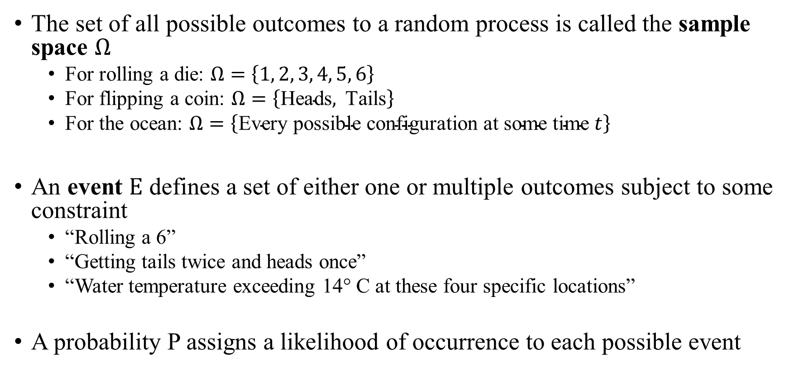
Probabilities
The set of all possible outcomes to a random process is called the sample space $Ω$
  For rolling a die: $Ω=\left\{1, 2, 3, 4, 5, 6\right\}$
  For flipping a coin: $Ω=\left\{\text{Heads},\text{ Tails}\right\}$
  For the ocean: $Ω=\left\{\text{Every possible configuration at some time }t\right\}$
An event $E$ defines a set of either one or multiple outcomes subject to some constraint
  “Rolling a 6”
  “Getting tails twice and heads once”
  “Water temperature exceeding 14° C at these four specific locations”
A probability P assigns a likelihood of occurrence to each possible event

Slide 12
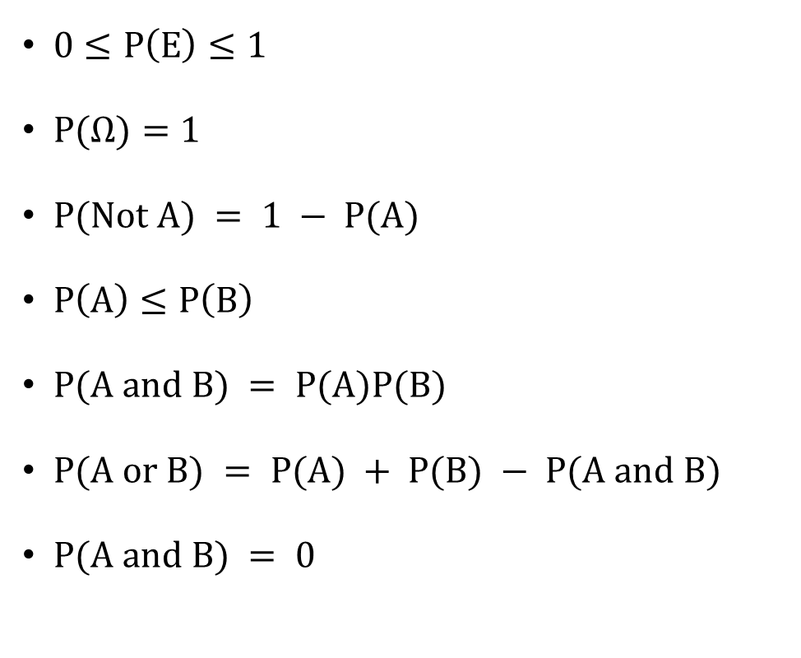

Probability Properties
$0≤P\left(E\right)≤1$
$P(Ω)=1$
$P(Not A) = 1 − P(A)$
$P\left(A\right)≤P\left(B\right)$
$P(A and B) = P(A)P(B)$
$P(A or B) = P(A) + P(B) − P(A and B)$
$P(A and B) = 0$
Probability of any individual event is between 0 and 1
All possible outcomes live inside $Ω$
Probability of occurring + probability of not occurring = 1
if A is a subset of B
if A and B are independent
if A and B are mutually exclusive

Slide 13
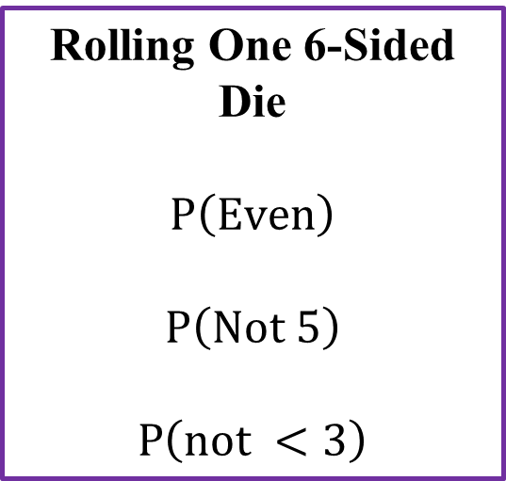
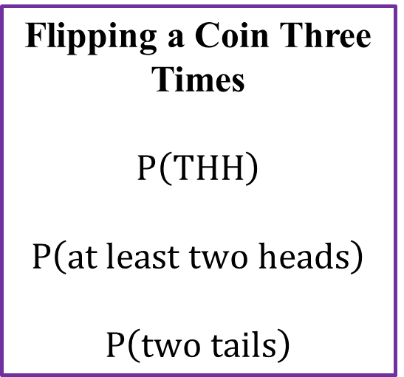
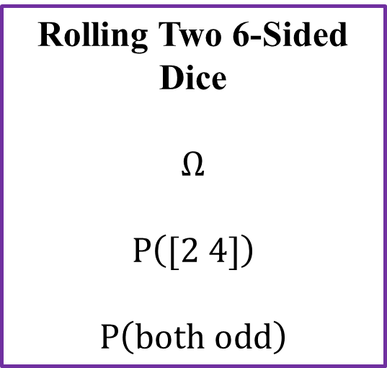
Probability Practice
Rolling One 6-Sided Die
$$P\left(\text{Even}\right)$$
$$P\left(\text{Not 5}\right)$$
$$P\left(\text{not }<3\right)$$
Rolling Two 6-Sided Dice
$$Ω$$
$$P\left(\text{[2 4]}\right)$$
$$P\left(\text{b}oth odd\right)$$
Flipping a Coin Three Times
$$P\left(\text{TH}H\right)$$
$$P\left(\text{at least two heads}\right)$$
$$P\left(\text{two tails}\right)$$

Slide 14
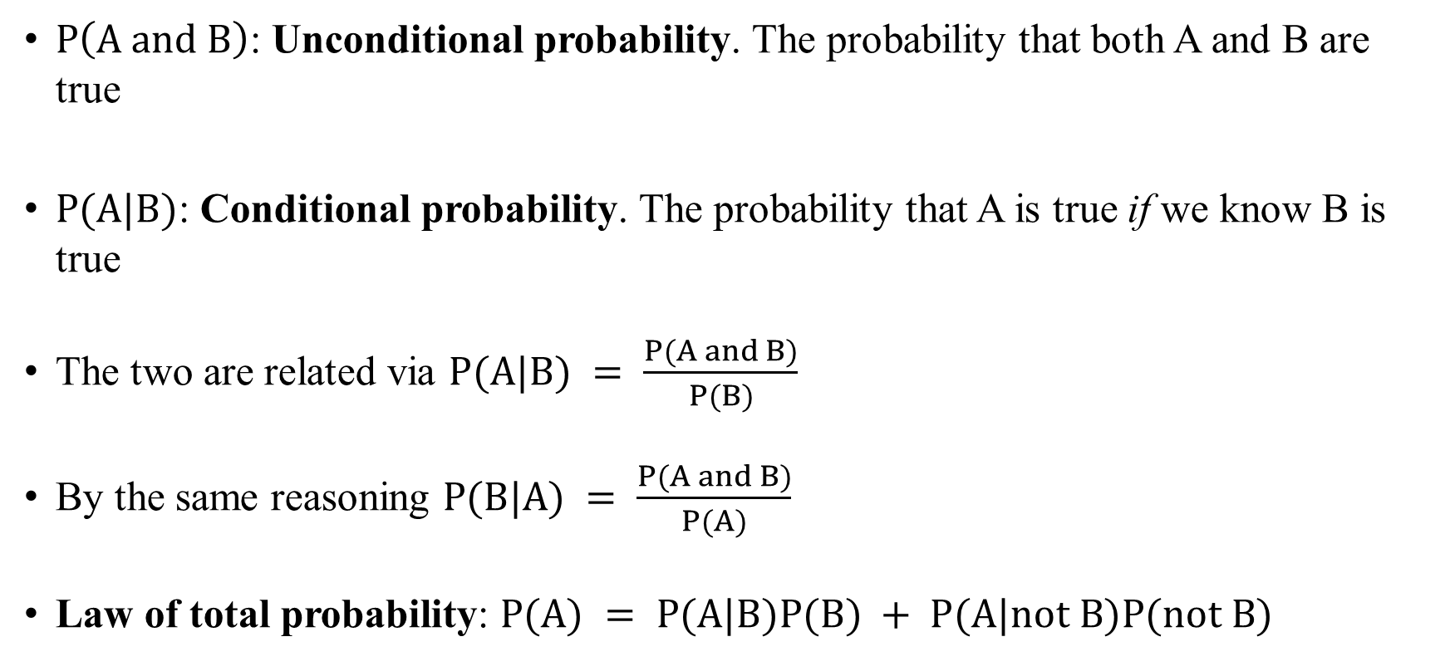
Unconditional and Conditional Probabilities
$P\left(\text{A and B}\right)$: Unconditional probability. The probability that both A and B are true
$P(A|B)$: Conditional probability. The probability that A is true if we know B is true
The two are related via $P(A|B) = \frac{P(A and B)}{P(B)}$
By the same reasoning $P(B|A) = \frac{P(A and B)}{P(A)}$
Law of total probability: $P(A) = P(A|B)P(B) + P(A|not B)P(not B)$

Slide 15
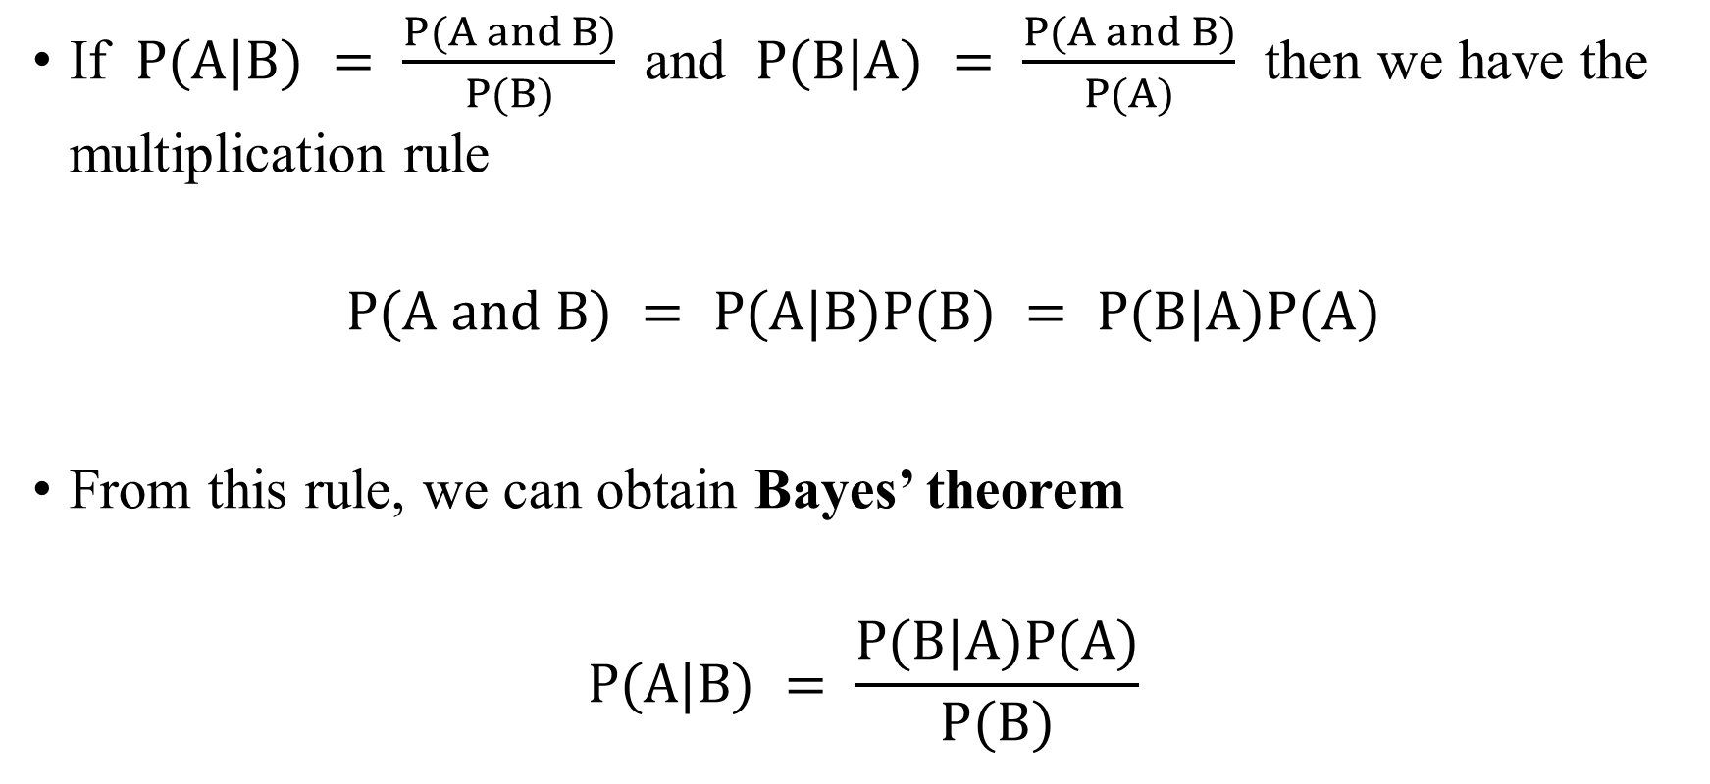
Bayes’ Theorem
If $P(A|B) = \frac{P(A and B)}{P(B)}$ and $P(B|A) = \frac{P(A and B)}{P(A)}$ then we have the multiplication rule
$$P(A and B) = P(A|B)P(B) = P(B|A)P(A)$$
From this rule, we can obtain Bayes’ theorem
$$P(A|B) = \frac{P(B|A)P(A)}{P(B)}$$

Slide 16
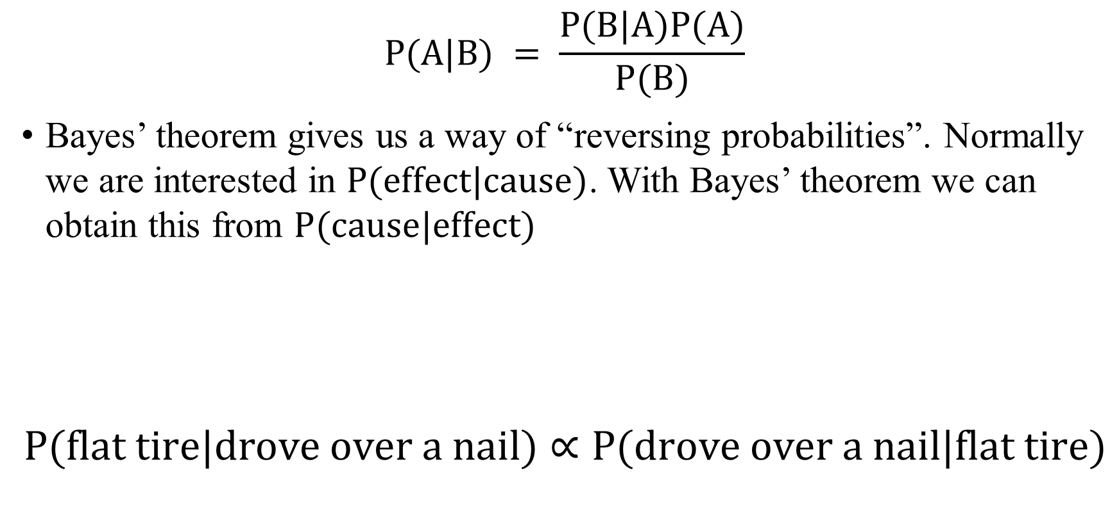
Bayes’ Theorem
$$P(A|B) = \frac{P(B|A)P(A)}{P(B)}$$
Bayes’ theorem gives us a way of “reversing probabilities”. Normally we are interested in $P(effect|cause)$. With Bayes’ theorem we can obtain this from $P(cause|effect)$
$$P(flat tire|drove over a nail)∝P(drove over a nail|flat tire)$$
Example:

Slide 17
Bayes’ Theorem Practice
Baye’s theorem gives us a way of inverting our probabilities. Usually, we want to probability of an effect given its cause, and through Baye’s theorem we can get that from the probability of a cause, given its effect
Practice: Harmful algal blooms (HAB’s) occur about 10% of days and are tracked by satellite measurements. Satellites successfully identify HAB’s 80% of the time and have a false positive rate of 15%. The satellite tells us there is an HAB today, what is the probability of an HAB occurring?

Slide 18
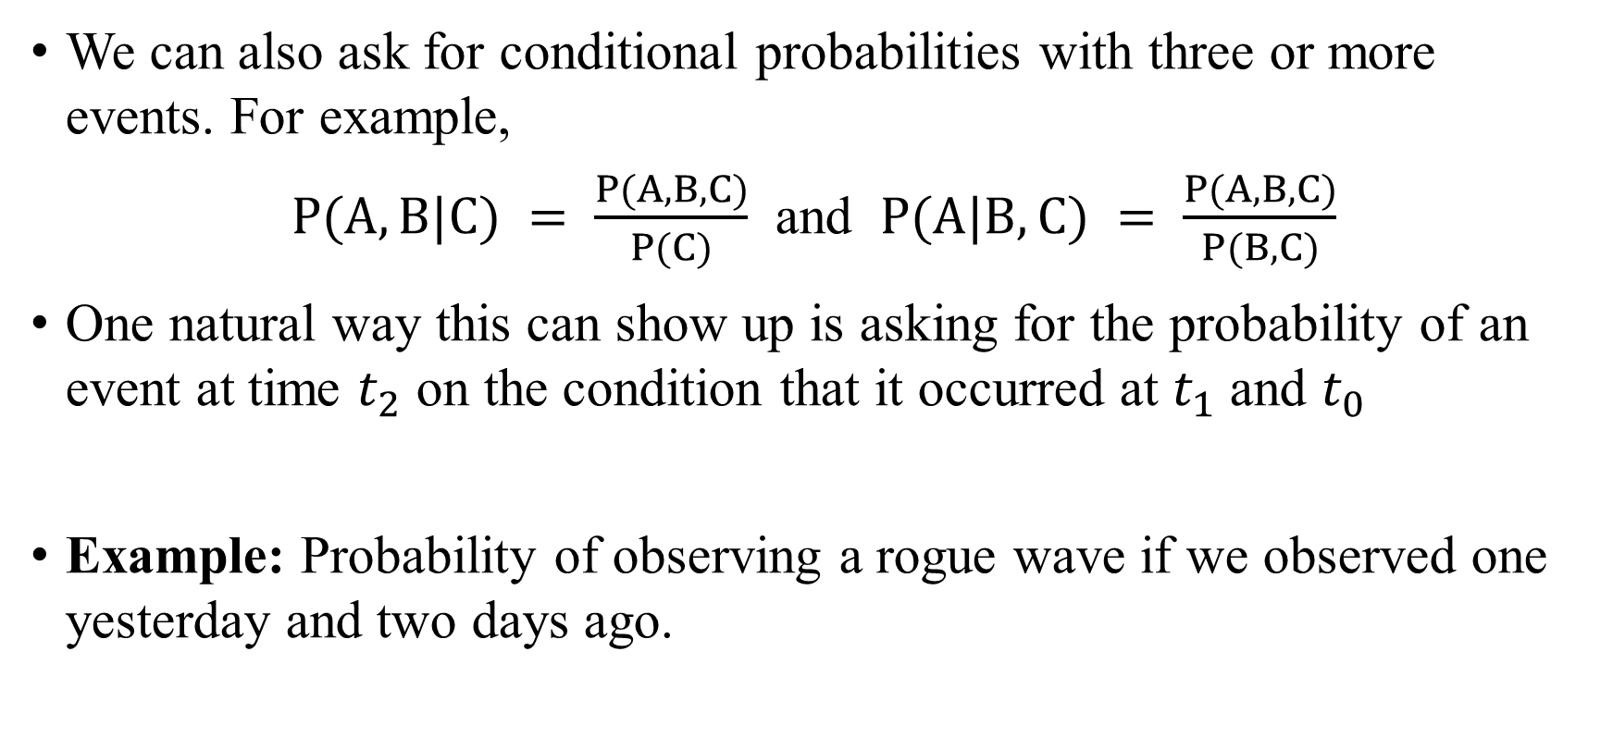
Conditional Probabilities
We can also ask for conditional probabilities with three or more events. For example,
$P(A,B|C) = \frac{P(A,B,C)}{P(C)}$ and $P(A|B,C) = \frac{P(A,B,C)}{P(B,C)}$
One natural way this can show up is asking for the probability of an event at time $t_{2}$ on the condition that it occurred at $t_{1}$ and $t_{0}$
Example: Probability of observing a rogue wave if we observed one yesterday and two days ago.

Slide 19
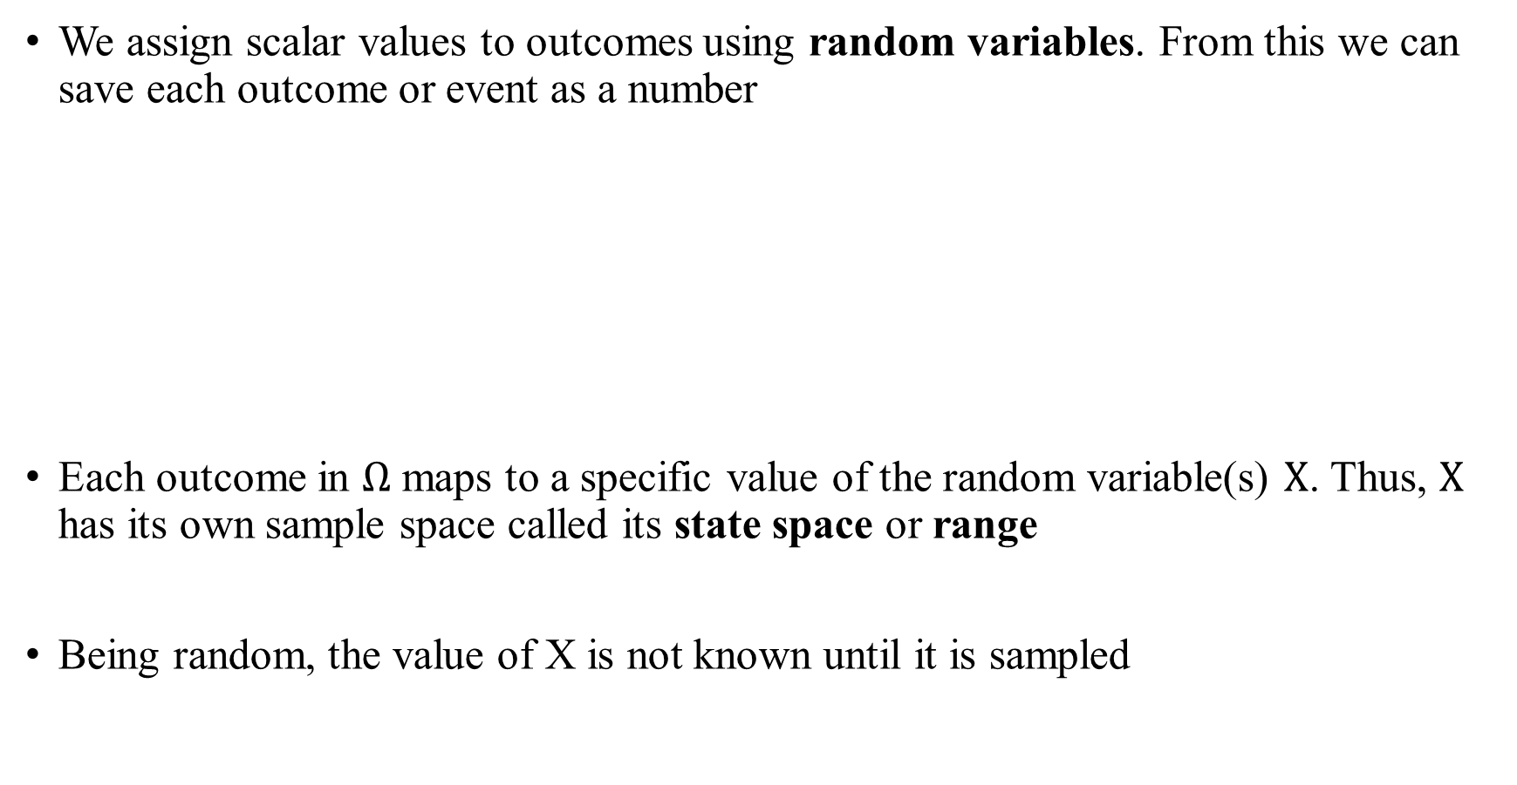
Random Variables
We assign scalar values to outcomes using random variables. From this we can save each outcome or event as a number
Each outcome in $Ω$ maps to a specific value of the random variable(s) $X$. Thus, $X$ has its own sample space called its state space or range
Being random, the value of X is not known until it is sampled
Outcome/Event
Random Variable
The result of a die roll
Flipping tails three times in a row
The configuration of the ocean
The number on the top face
The number of tails
Values of the state variables

Slide 20
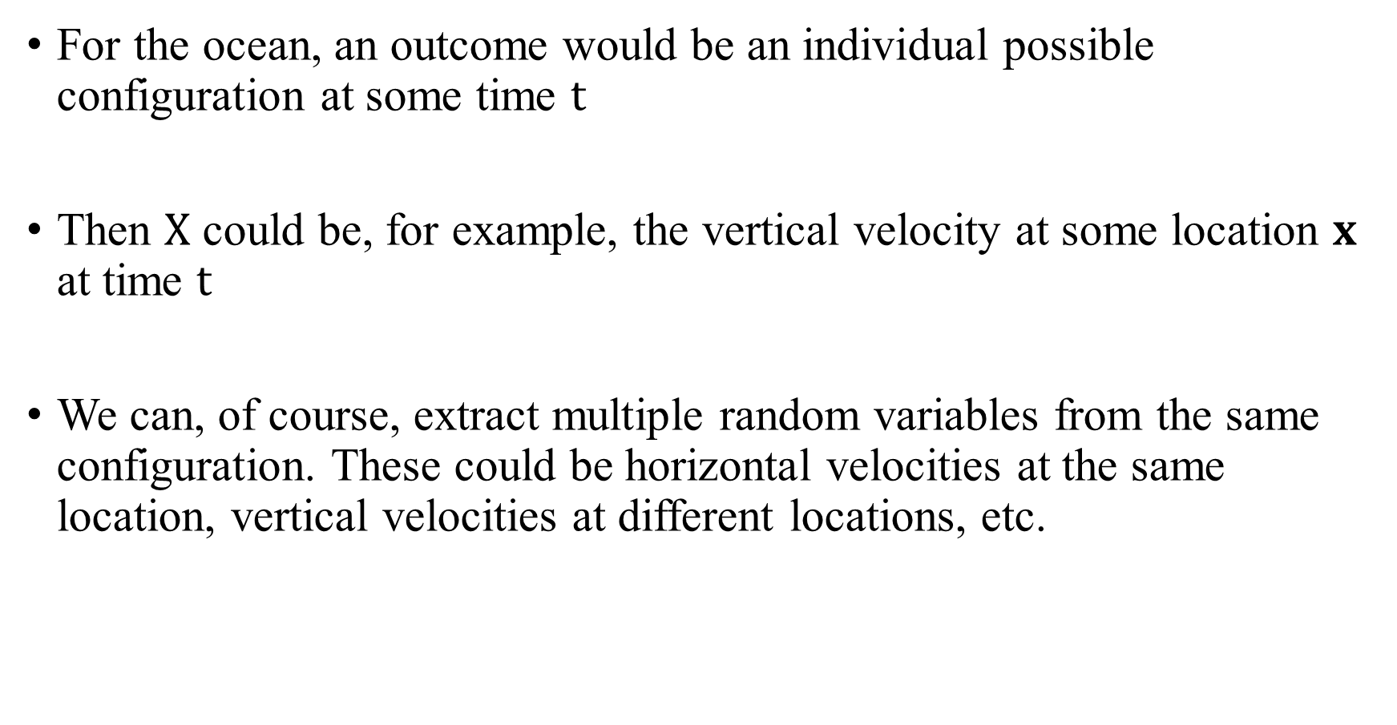
Random Variables
For the ocean, an outcome would be an individual possible configuration at some time $t$
Then $X$ could be, for example, the vertical velocity at some location $x$ at time $t$
We can, of course, extract multiple random variables from the same configuration. These could be horizontal velocities at the same location, vertical velocities at different locations, etc.

Slide 21
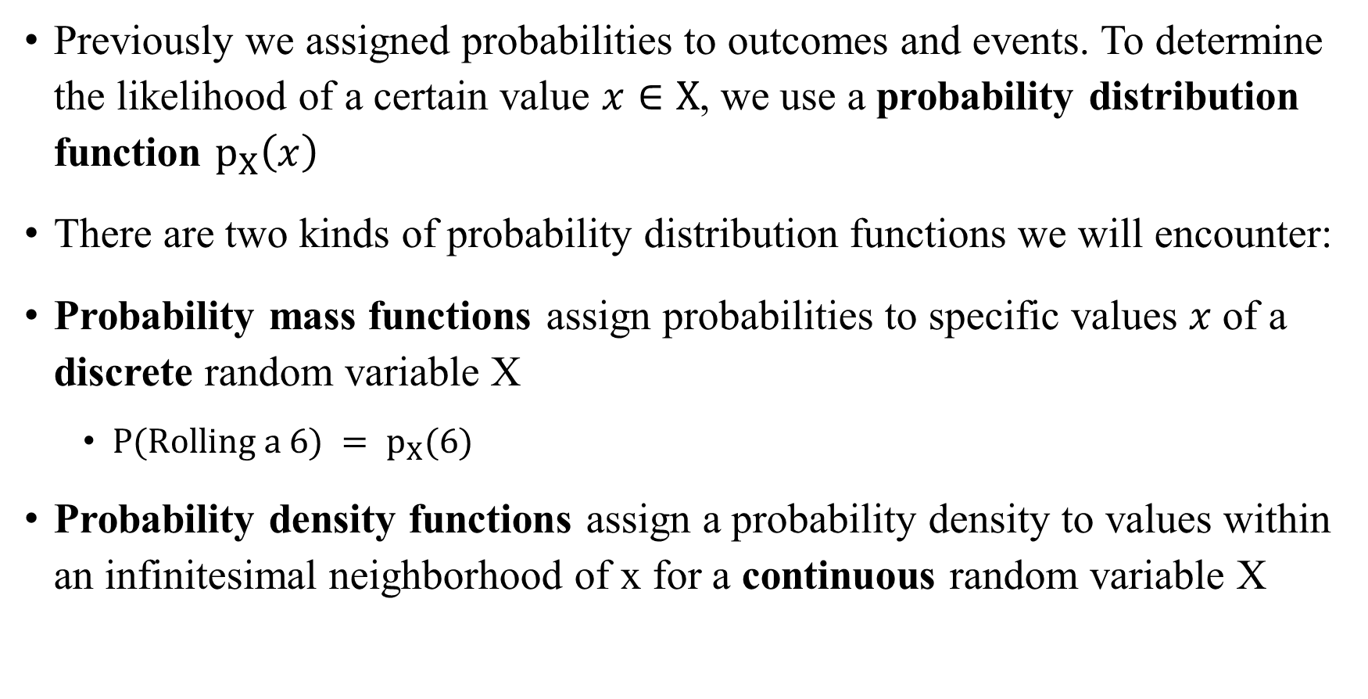
Probability Distributions
Previously we assigned probabilities to outcomes and events. To determine the likelihood of a certain value $x∈X$, we use a probability distribution function $p_{X}\left(x\right)$
There are two kinds of probability distribution functions we will encounter:
Probability mass functions assign probabilities to specific values $x$of a discrete random variable X
  $P(Rolling a 6) = p_{X}(6)$
Probability density functions assign a probability density to values within an infinitesimal neighborhood of x for a continuous random variable X

Slide 22
Empirical and Theoretical Probabilities
With the probability distribution, there are all sorts of powerful statistical techniques we can exploit
  Moments
  Cumulants
  Correlations
  Confidence intervals
To obtain the probability distribution, there are two main sources we will use
  Empirical probabilities
  Theoretical probabilities

Slide 23
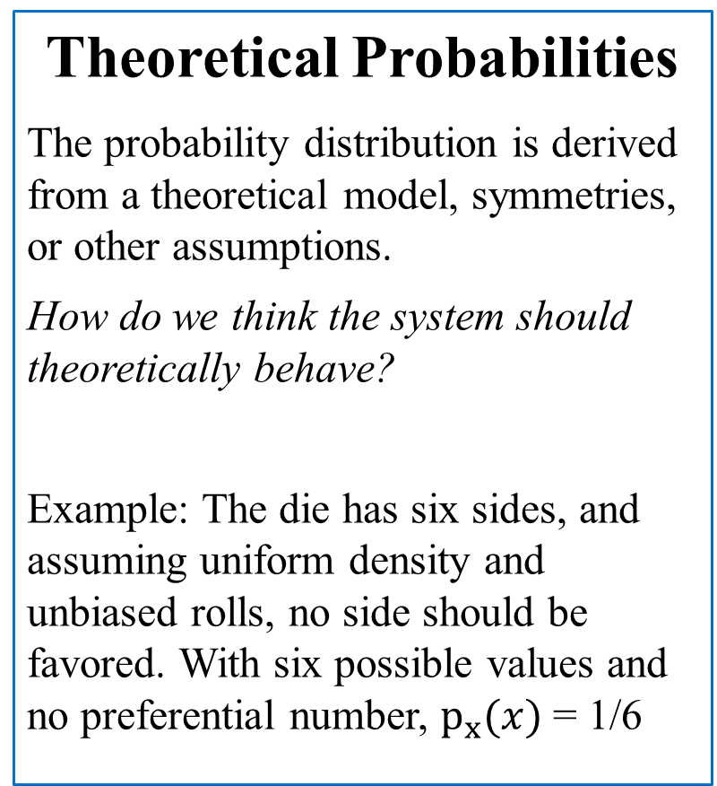
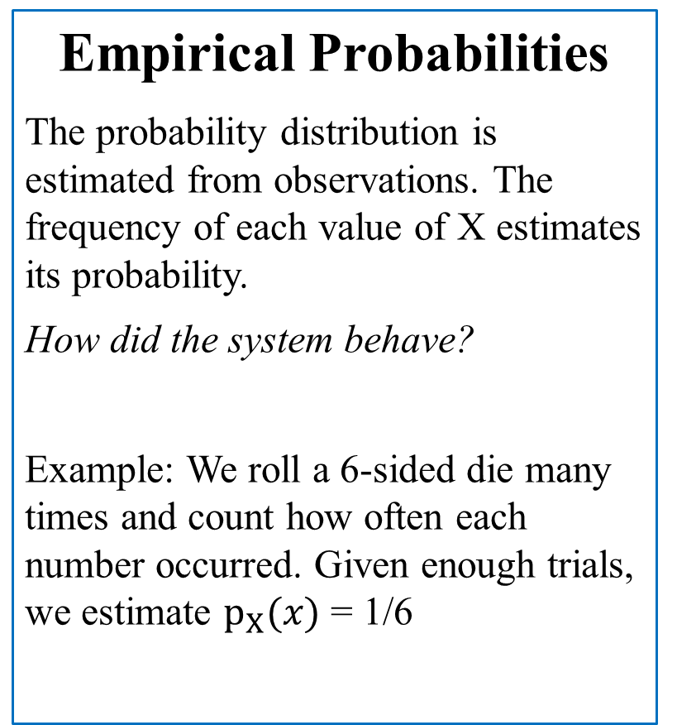
Empirical and Theoretical Probabilities
Empirical Probabilities
The probability distribution is estimated from observations. The frequency of each value of X estimates its probability.
How did the system behave?
Example: We roll a 6-sided die many times and count how often each number occurred. Given enough trials, we estimate $p_{X}(x)$ = 1/6
Theoretical Probabilities
The probability distribution is derived from a theoretical model, symmetries, or other assumptions.
How do we think the system should theoretically behave?
Example: The die has six sides, and assuming uniform density and unbiased rolls, no side should be favored. With six possible values and no preferential number, $p_{x}(x)$ = 1/6

Slide 24
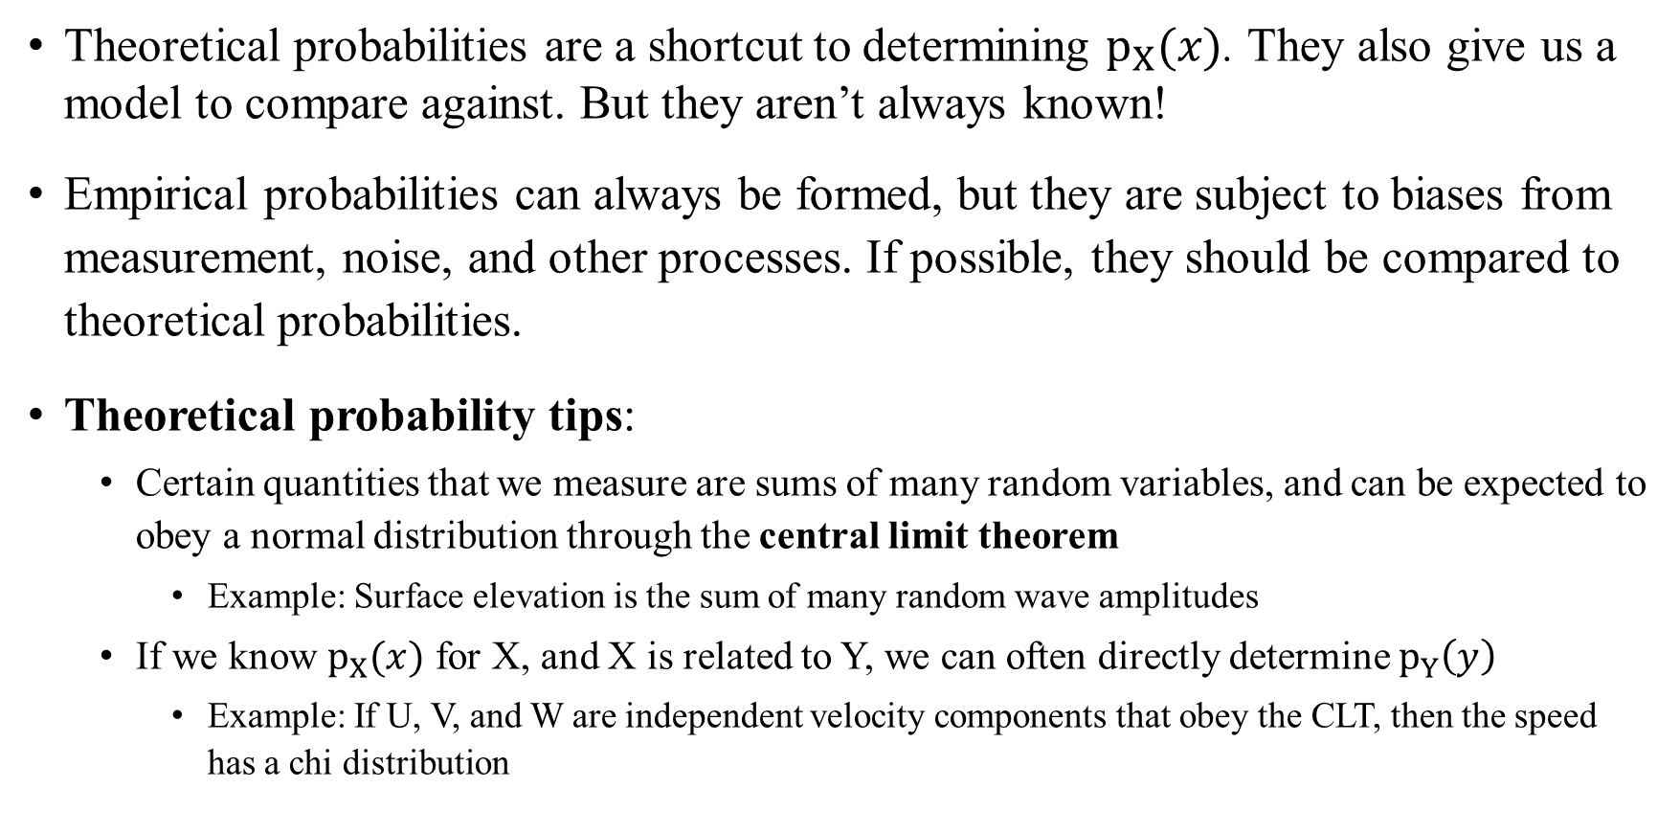
Empirical and Theoretical Probabilities
Theoretical probabilities are a shortcut to determining $p_{X}(x)$. They also give us a model to compare against. But they aren’t always known!
Empirical probabilities can always be formed, but they are subject to biases from measurement, noise, and other processes. If possible, they should be compared to theoretical probabilities.
Theoretical probability tips:
  Certain quantities that we measure are sums of many random variables, and can be expected to obey a normal distribution through the central limit theorem
    Example: Surface elevation is the sum of many random wave amplitudes
  If we know $p_{X}(x)$ for X, and X is related to Y, we can often directly determine $p_{Y}\left(y\right)$
    Example: If U, V, and W are independent velocity components that obey the CLT, then the speed has a chi distribution

